Slide 1
Quantitative Surveys

Slide 2
Survey Content
Most surveys are designed to gather data about:
Demographics
How many years have you been teaching?
Behaviors
How do you deal with students who are off-task?
Attitudes or Opinions
Are your students receiving sufficient parental support?
IRB: Is it possible that the answer to any of these questions might cause the respondent harm?

Slide 3
Response Categories
The respondent must be able to recognize him or herself in the response categories.
Exhaustive—Response categories must encompass all possible responses.
  Using “other”
Mutually Exclusive—Respondents must be able to clearly distinguish among response categories.

Slide 4
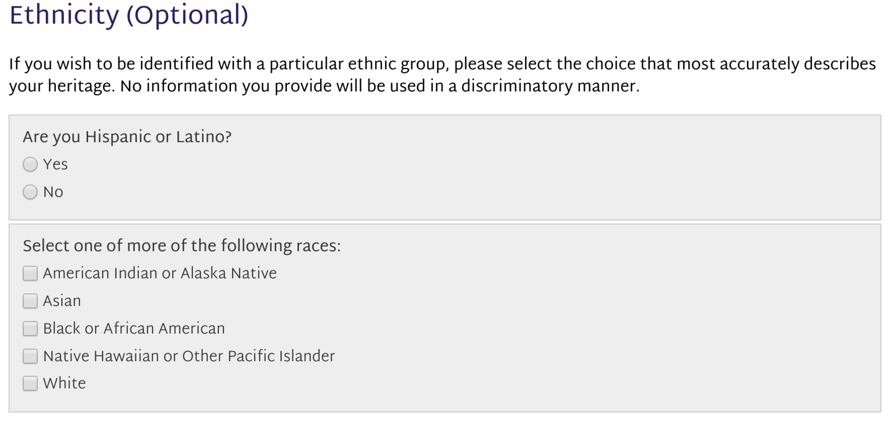
Exhaustive and Mutually Exclusive

Slide 5
Language Bias
Since surveys are by definition self-report data, most surveys are designed to gather opinion data.
Since opinion data are by definition subjective, quantifying survey data is difficult.
All respondents must interpret the questions in the same way.
All respondents must interpret the response categories in the same way.

Slide 6
Quantifying Responses
Open-Ended Questions
  Rubrics
Questions with Response Categories
  Figuring out how to make response categories evenly spaced

Slide 7
Quantifying Opinions
The general strategy is to get respondents to place themselves on a provided response continuum.
Using a continuum improves the ability to represent an opinion on an interval scale.
This strategy violates lots of basic statistical assumptions.
Our job is to mitigate those violations.

Slide 8
Interval Scales
Equal Spaced Response Categories
Logic of response categories must imply the categories are equally spaced.
Awful Poor Good Excellent

Slide 9
Interval Scales
Equal Spaced Response Categories
Rate your supervisor on congeniality.
lowest 1 2 3 4 5 6 7 highest
Anchors labeled with intermediate points numbered.

Slide 10
Interval Scales
Equal Spaced Response Categories
My supervisor is:
very unpleasant—unpleasant—pleasant—very pleasant
Anchors labeled with intermediate points labeled.

Slide 11
Absolutes
Never Rarely Occasionally Always
Rarely Occasionally Commonly Most of the Time

Slide 12
Absolutes
Never Rarely Occasionally Always
Rarely Occasionally Commonly Most of the Time

Slide 13
Number of Response Categories
Strongly Disagree Disagree Agree Strongly Agree
• The more response categories the more information the survey provides (data degradation)
• At some point too many response categories make it difficult for the respondent to answer
Very Strongly Disagree Strongly Disagree Disagree Not Sure Agree Strongly Agree Very Strongly Agree

Slide 14
Number of Response Categories
Strongly Disagree Disagree Agree Strongly Agree
Strongly Disagree Disagree Not Sure Agree Strongly Agree
• Is the center point a reasonable response on the continuum?
• Does a response on the center point mean that the respondent can not or will not answer the question in one direction or another?
• If you are not sure what a response means then you can not analyze it.

Slide 15
Symmetrical Responses
Equal weight of responses needs to feel like it is on both sides of the middle.
Never Seldom Sometimes Usually
Strongly Disagree Disagree Agree Strongly Agree

Slide 16
Interval Scales
Equal Spaced Response Categories
Designing response categories for interval analysis
  Avoid absolutes
  Select the number of intermediate responses
  Design responses as symmetrical
  Label all response categories
  Responses normally listed negative to positive (maybe)

Slide 17
Quantitative Survey Research
(Turning perceptions into numbers)
Indices
Scales
Semantic Differentials
Likert Scales

Slide 18
Index
Counts responses within a category
If the things being counted are equivalent then index can be considered interval
Instructions are select all that apply

Slide 19
Index
2. Have you read the following? (select all that apply)
A Public Trust at Risk: The Heritage Health Index Report on the State of America's Collections booklet
Case studies on this website
Resource page on this website
The Heritage Health Index Full Report (PDF file on this website)
Other page(s) on this website
None of the above
4. Do you plan to share the information from the Heritage Health Index with any of the following? (select all that apply)
Colleagues at your institution
Colleagues in your field
Professional organizations
Foundations or other funders
Media
Institutional leadership/governing body
Federal government officials or legislators
State government officials or legislators
Local government officials or legislators
Other

Slide 20
Scales
Respondent selects one answer from a list which represents increasing levels of a single characteristic.
Only one response can be selected

Slide 21
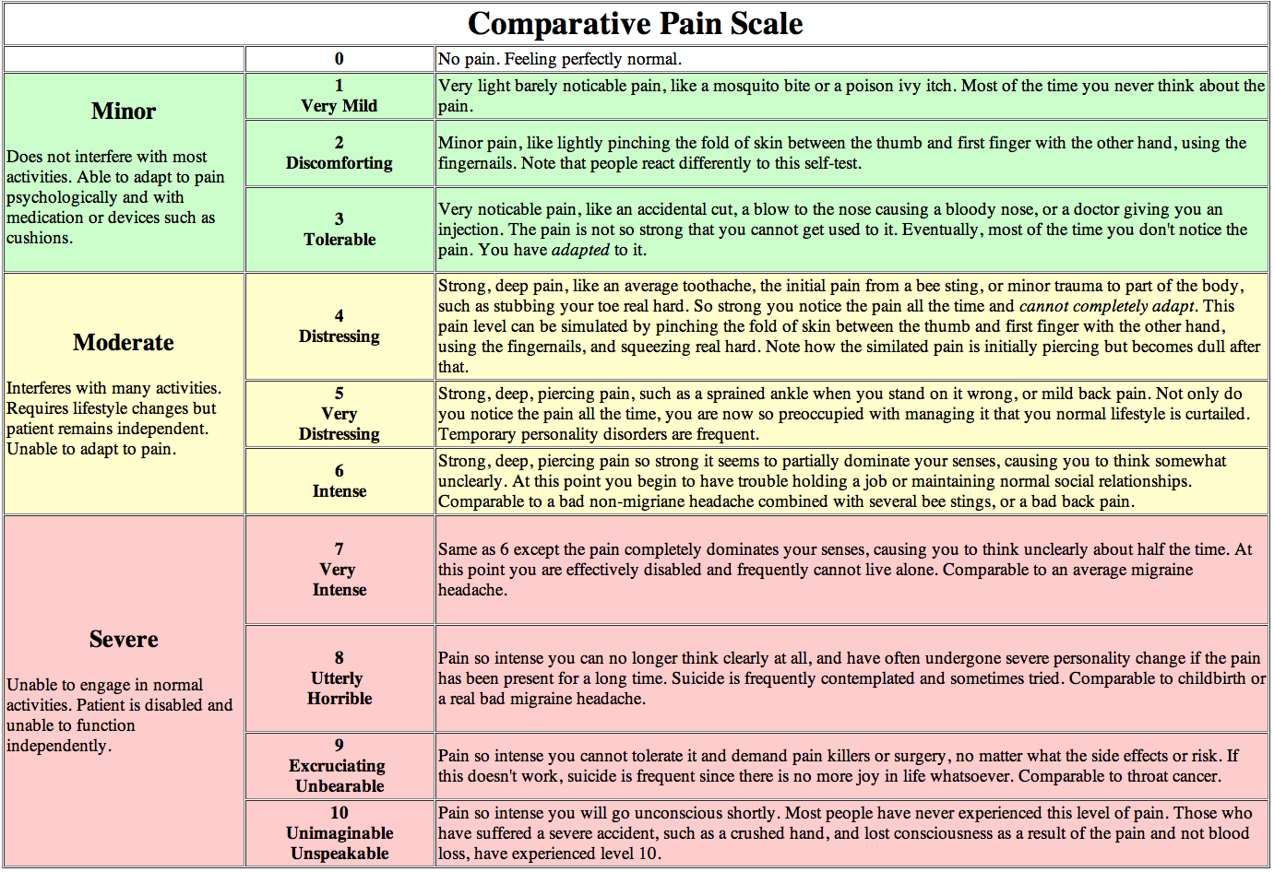

Slide 22
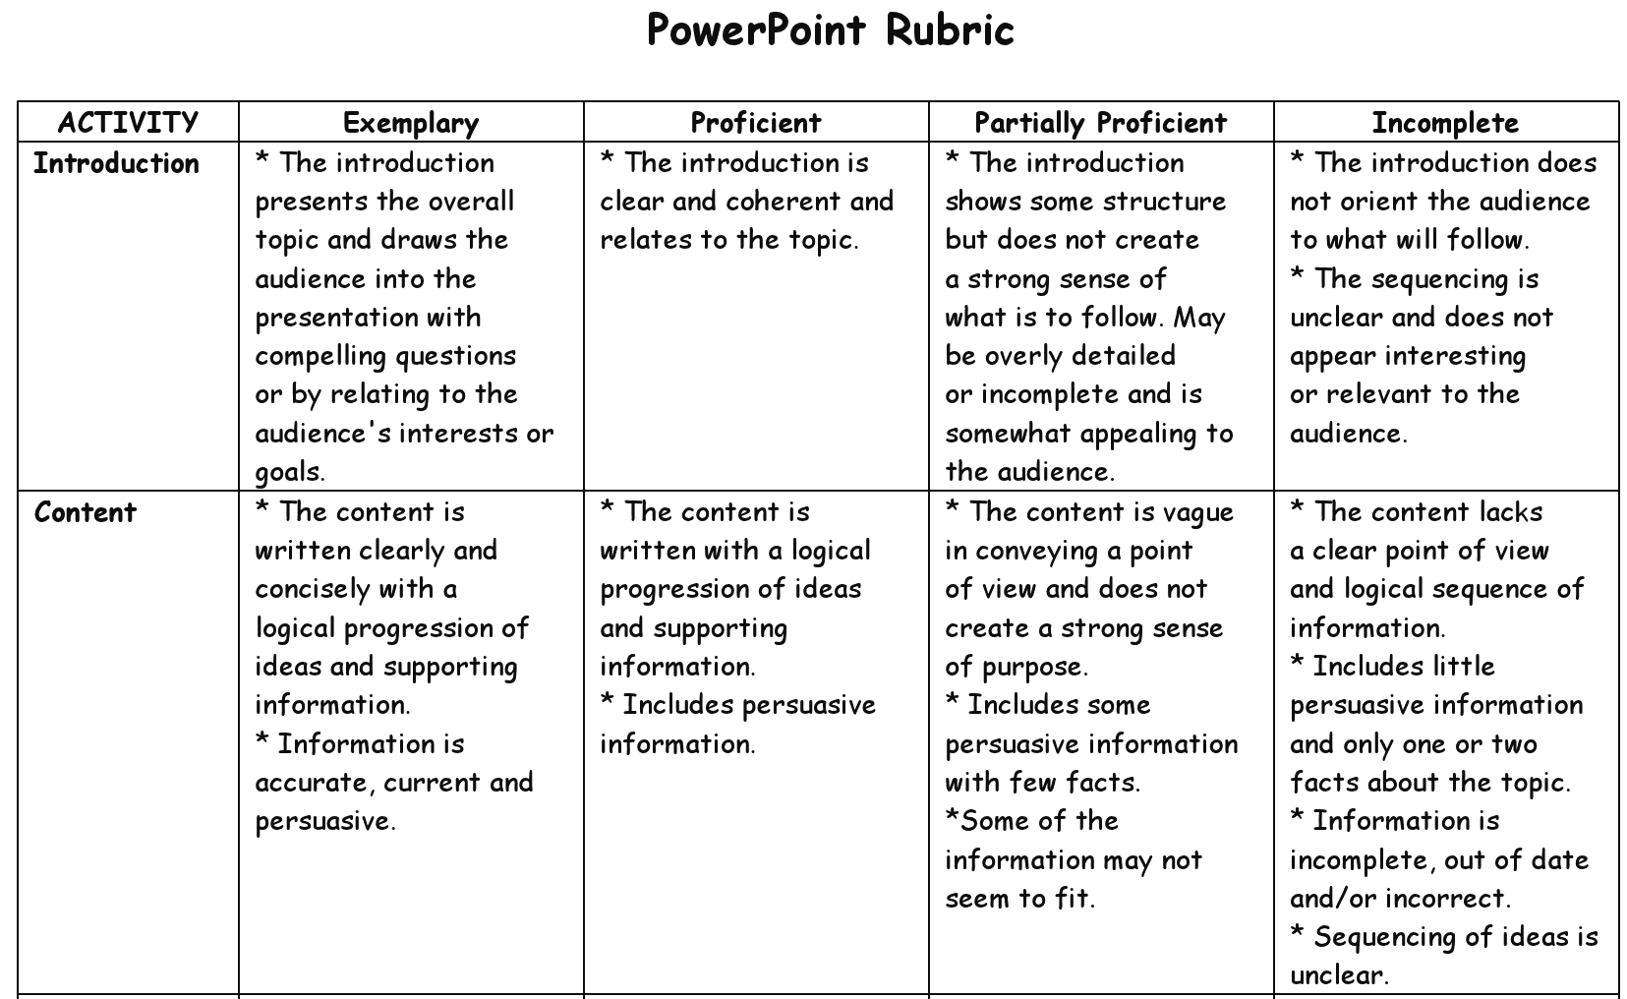

Slide 23
Semantic Differential
Selection of a point on a continuum anchored by opposites
Sometimes designed as forced choice scales
Difficult to design with any reliability

Slide 24
Coffee Preferences
Semantic Differential
I like my coffee:
boiling hot ice cold
I prefer coffee in a:
tiny cup gallon jar
In terms of sweetness, I prefer:
no sugar 50% sugar
0 1 2 3 4 5

Slide 25
Semantic Differential
(forced choice)
Circle the choice that best identifies you.
I consider myself old young
I am fit unfit
I prefer salads meat
For entertainment I stay home go out
Calisthenics are exhilarating depressing

Slide 26
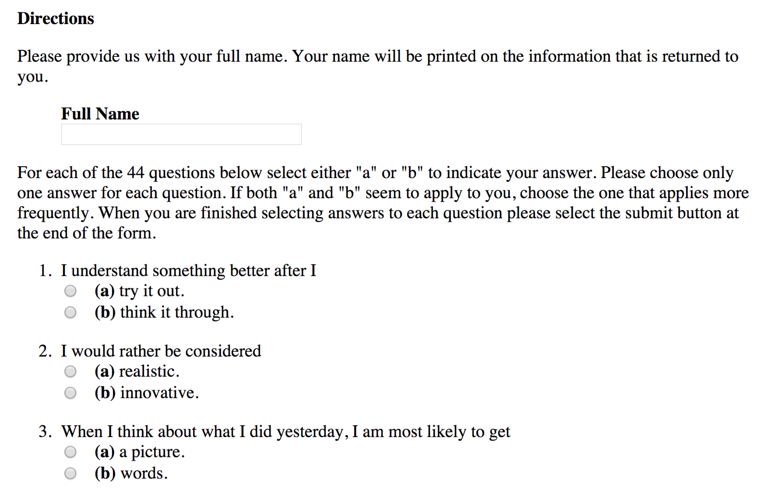
Index of Learning Styles Questionnaire
Barbara A. Soloman
Richard M. Felder
North Carolina State University

Slide 27
Likert Scales
Almost always assessment of attitude or opinion
Anchors on the scale remain constant through the instrument
Usually agree and disagree
Intermediate points should be labeled
Scale points are symmetrical
Likert, R. (1974). A method of constructing an attitude scale. In G. M. Maranell (Ed.) Scaling: A sourcebook for behavioural scientists, 233-243. New Brunswick, NJ: Aldine Transaction.

Slide 28
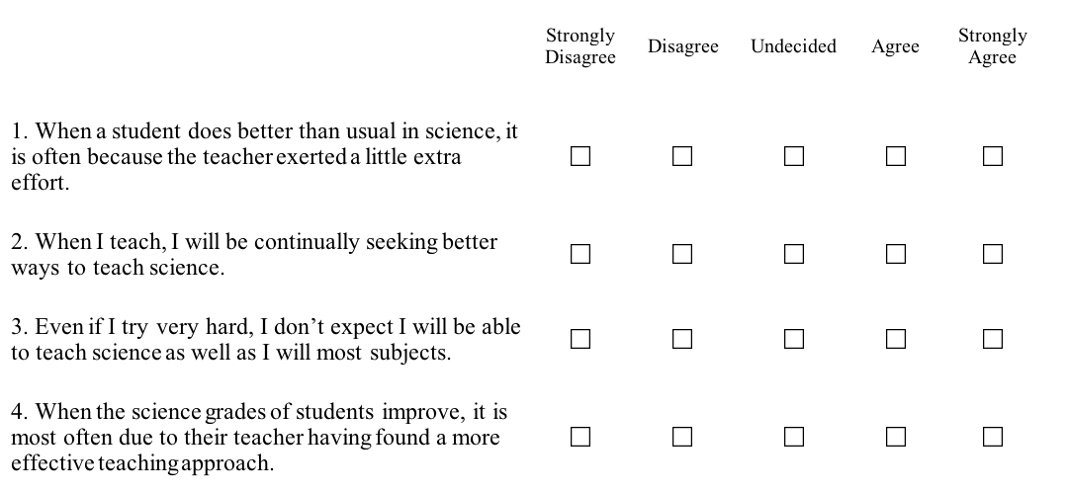
Science Teaching Self-Efficacy

Slide 29
Interval Scales
Equal Spaced Response Categories
These are still not really equally spaced.
Possible bias that appears from using not equally spaced response categories is minimized when multiple question around a given construct are analyzed simultaneously.
Analyze as a group first then as individual questions if you have to.
  Multivariate then univariate

Slide 30
Likert-Type Responses
https://www.surveylegend.com/likert-type-scale-responses-examples-with-examples/
(Also on the course resources page)

Slide 31
Instrument Design
  Anonymity versus confidentiality
Good instructions are short and clear.
The survey should be easy to complete and short.
Pay attention to question order (Dillman).
Be sure multiple questions do not ask for the same information.
Professional appearance
Space for responses.

Slide 33
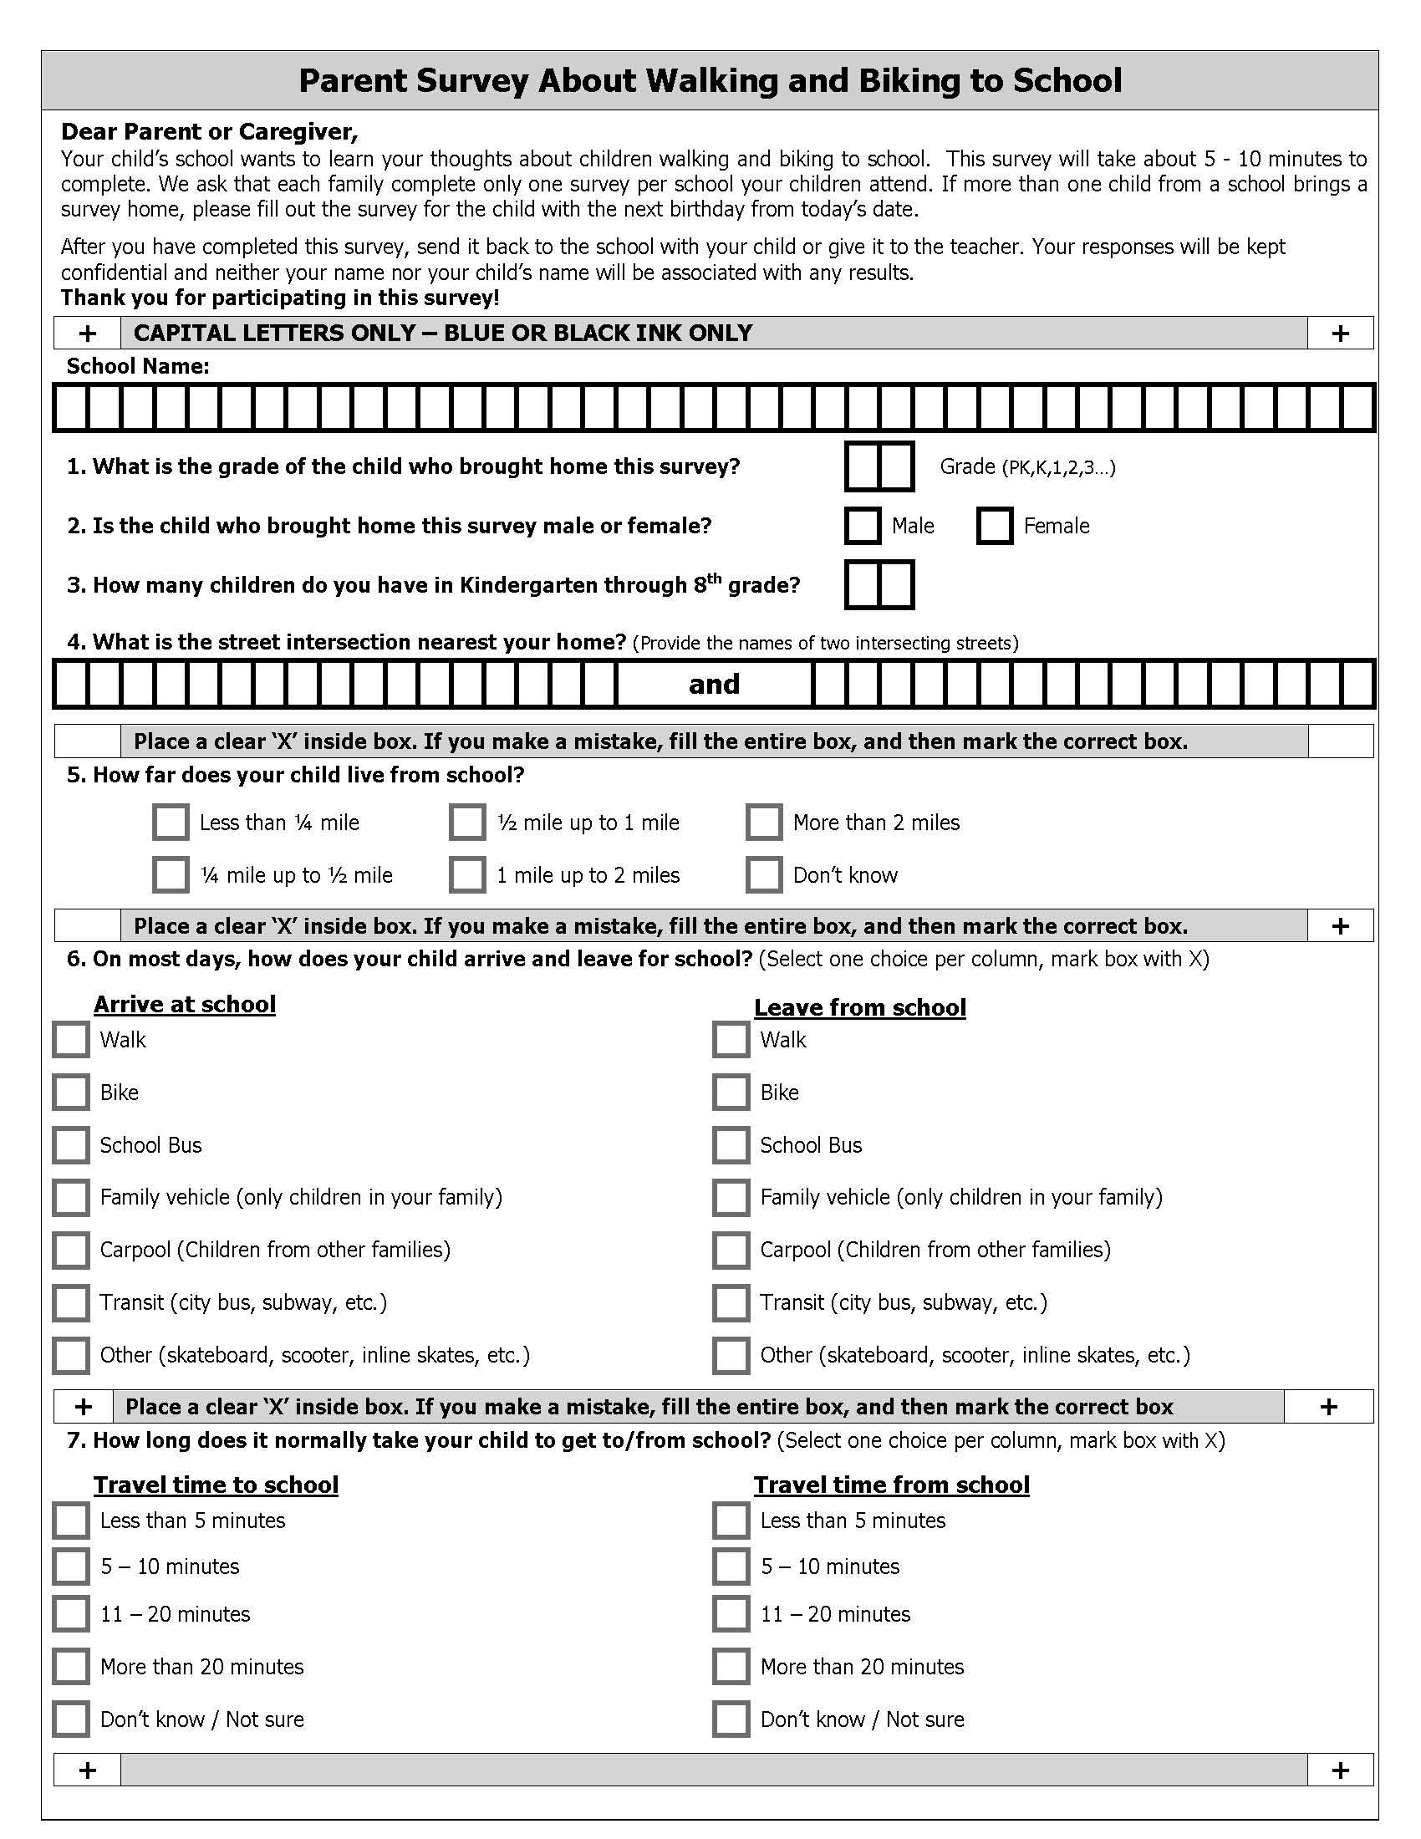

Slide 34
Administering Surveys
Be sure respondents know why they should complete the survey.
  What value will this be to the respondent?
Do you need support from those above you?
How will the surveys be administered?
How will they be returned?
How will you handle non-respondents?

Slide 35
Web-Based Surveys
The Rules
Assume that whoever gathers the data will know who the respondents are.
  Be upfront about this
  Figure out how to get people to the survey
  Design for confidentiality
  Ask for names
  Choose a different form of data gathering if these are problems

Slide 36
Web-Based Surveys
The Rules
Who owns the data dictates who has access to the data.
  If you are gathering proprietary or personal information about respondents should it be stored on a commercial server?
  If this is important, then you need to use survey tools that you own or not gather data electronically.

Slide 37
Web-Based Surveys
The Rules
Web-based surveys must look good on the web
  If you do not know how to do this then find someone who can.
  Commercial survey services usually do not give you very much control over appearance. There are exceptions.

Slide 38
Web-Based Surveys
The Rules
Web-based surveys must be easy to complete
  They must function flawlessly on every device, with every operating system, and with every browser (except maybe IE).
  They must be mind-numbingly simple
  They must follow all of the rules of good
  paper-based surveys

Slide 39
Web-Based Surveys
The Rules
Be sure you can control the quality of the data
  Have a way to know if the same person has responded twice
  Do not edit results online

Slide 40
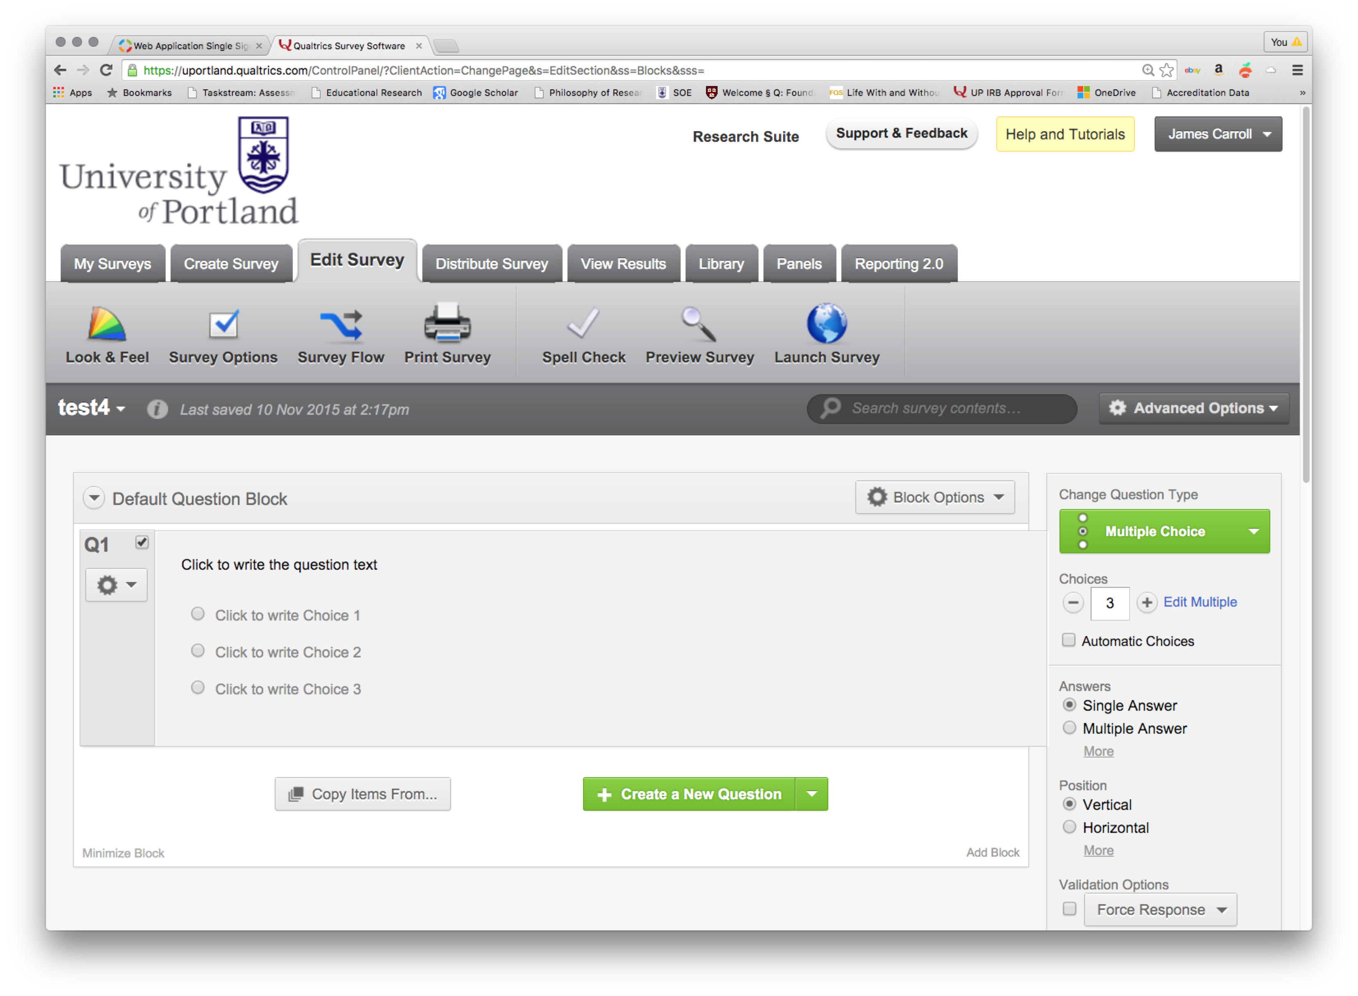
Qualtrics

Slide 41
The last and most important rule that should never ever be violated…
Pilot Test, Including Analysis!

